Slide 1
Pokemon Data Analysis
PORTFOLIO
PORTFOLIO
By Muhammad Rafli Fauzi

Slide 2

INTRODUCING
ABOUT ME
I am an active student of Sultan Ageng Tirtayasa University, Department of Electrical Engineering with a great passion for a career in Information and Technology (IT), especially Machine Learning, Data science, Data Analyst and AI.
During college I was active as a computer laboratory assistant, majoring in electrical engineering, where I was tasked with teaching other students who contracted practicum courses in the computer laboratory. I was able to do this well and stay focused on my studies so that I was able to get a good GPA.
Muhammad Rafli Fauzi
Student

Slide 3
2022/2023 – Present
Sultan Ageng Tirtayasa University
EDUCATION
Active student of electrical engineering major
I am currently a student in the department of electrical engineering, faculty of engineering, Sultan Ageng Tirtayasa University. Previously I studied at SMK 4 Negeri Jakarta with a major in mechatronics engineering.
2018/2019 – 2021/2022
SMK 4 Negeri Jakarta
Graduate from mechatronics major

Slide 4




personal
SKILLS
Python Language Programming
Google Colaboratoty
I have a strong interest in IT, especially related to AI, Machine Learning, Data Science and Data Analyst. Some of the skills I have include.
Ms. Office
Visual Studio Code

Slide 5
01
HIGHEST VALUE
Analyze the pokemon with the highest values in each column in the table. Starting from HP, Attack, Defense and Speed.
Pokemon Data Analysis
02
LOWEST VALUE
PORTFOLIO
Analyze the pokemon with the highest values in each column in the table. Starting from HP, Attack, Defense and Speed.
This project portfolio was created in order to fulfill the bootcamp assignment from dibimbing.id. In this portfolio, I try to analyze the pokemon with the highest and lowest values in the HP, Attack, Defense and Speed columns. In addition, I also made a graph of the total number of each type of pokemon available.
03
NUMBER OF EACH TYPE
Analyze the number of each type of pokemon in the Type 1 and Type 2 columns, and display them as a bar chart.

Slide 6
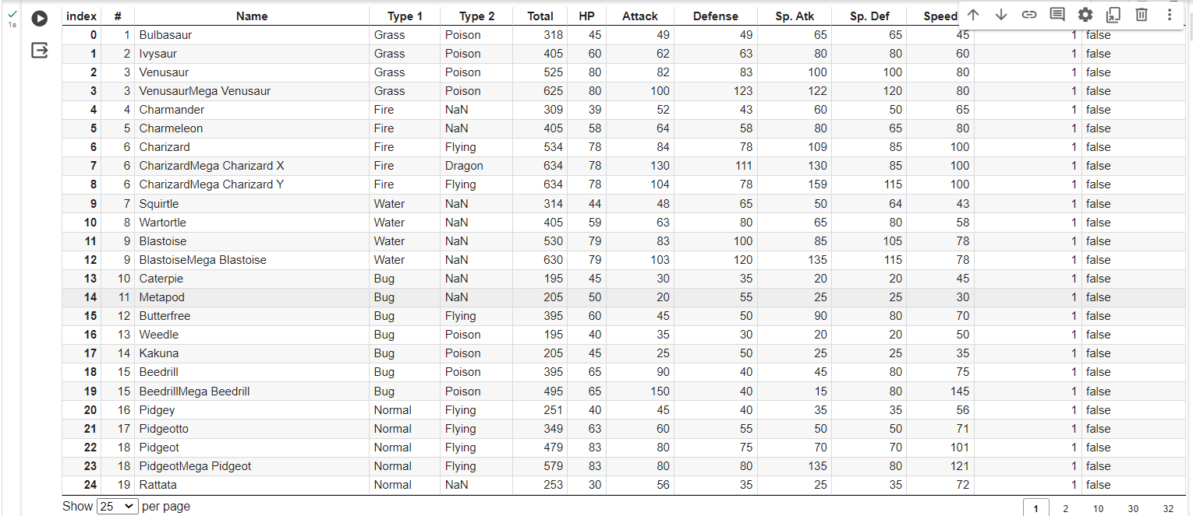
Pokemon Dataset

Slide 7


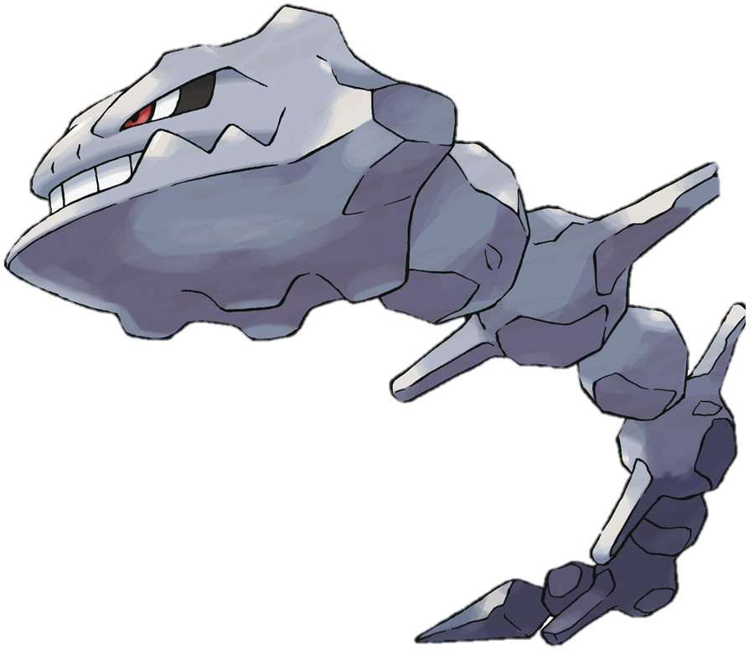
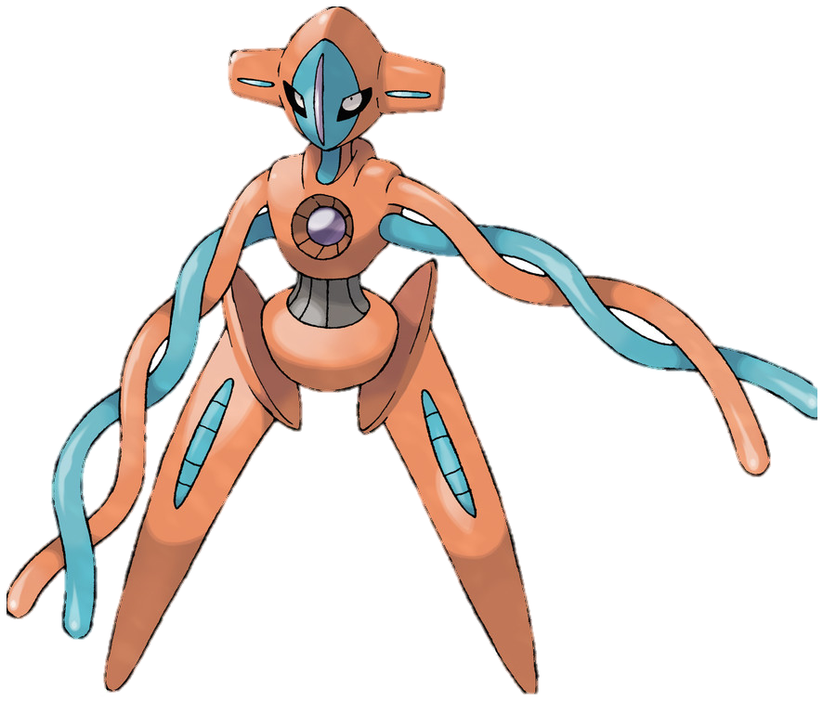
01. HIGHEST VALUE
The pokemon with the highest scores for the HP, Attack, Defense and Speed columns.
The Pokemon with the highest HP value is Blissey with a value of 255.
The Pokemon with the highest Attack value is MewtwoMega Mewtwo X with a value of 190.
The Pokemon with the highest Defense value is SteelixMega Steelix with a value of 230.
The Pokemon with the highest Speed value is DeoxysSpeed Forme with a value of 180.

Slide 8
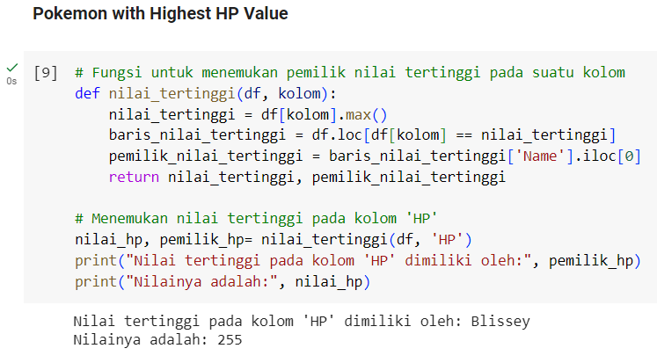
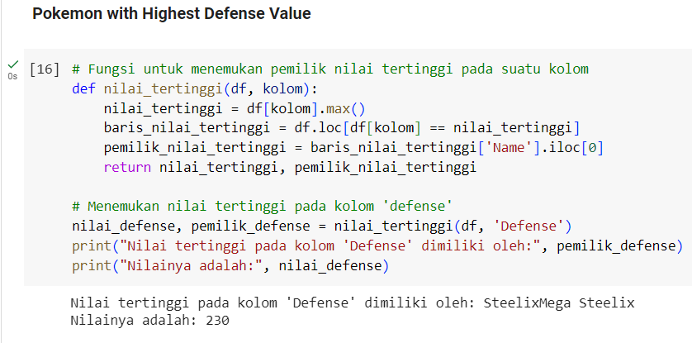
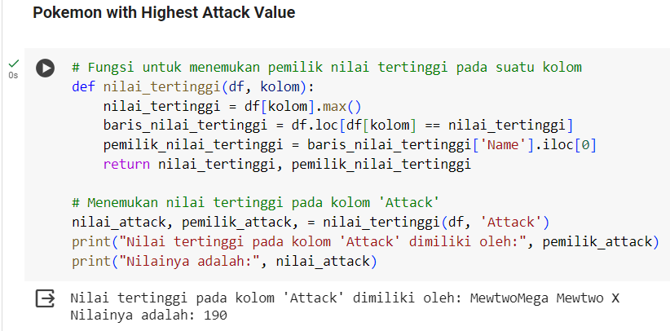
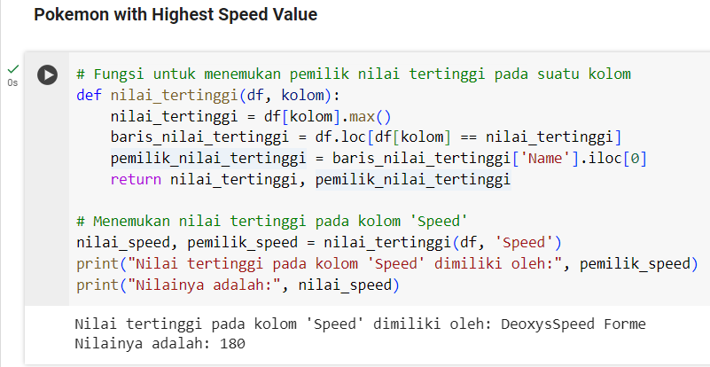
The results regarding who are the pokemon who have the highest value in the HP, Attack, Defense and Speed columns are obtained using the program code as follows.

Slide 9



02. LOWEST VALUE
The pokemon with the lowest scores for the HP, Attack, Defense and Speed columns.
The Pokemon with the lowest HP value is Shedinja with a value of 1.
The Pokemon with the lowest Attack and Defense value is Chansey with a value of 5.
The Pokemon with the lowest speed value is Shuckle with a value of 5.

Slide 10
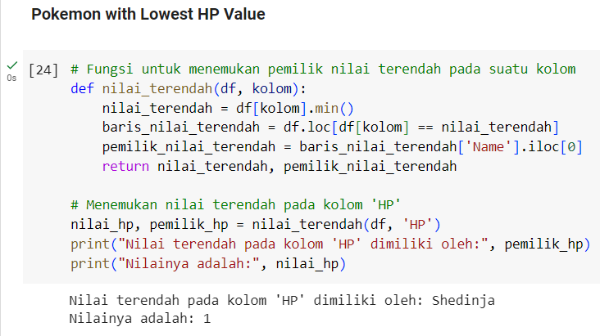
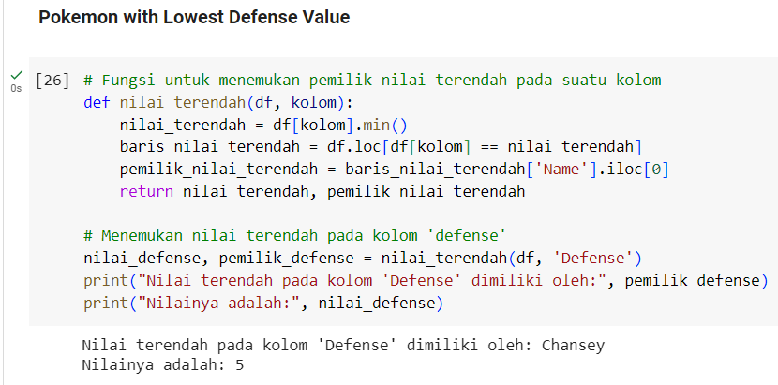
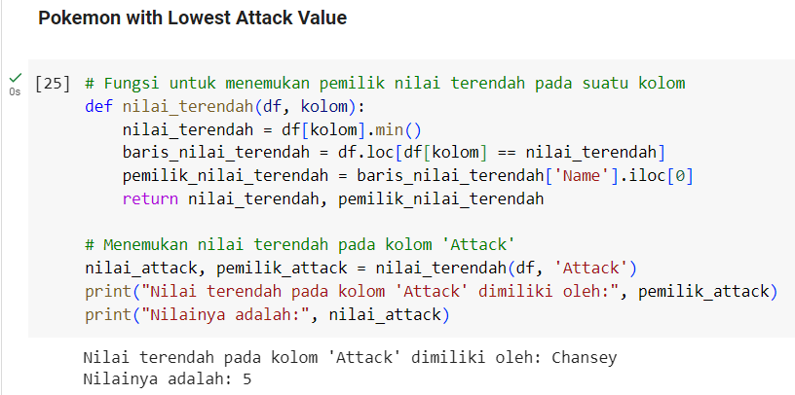
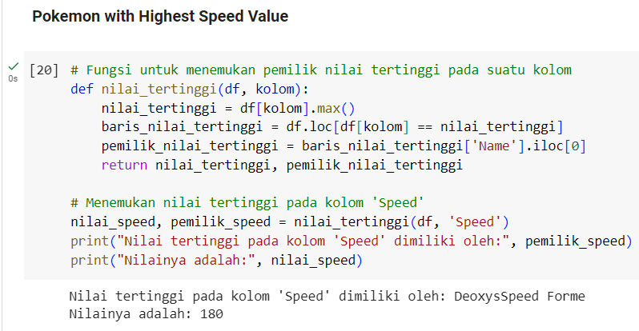
The results regarding who are the pokemon who have the lowest value in the HP, Attack, Defense and Speed columns are obtained using the program code as follows.

Slide 11
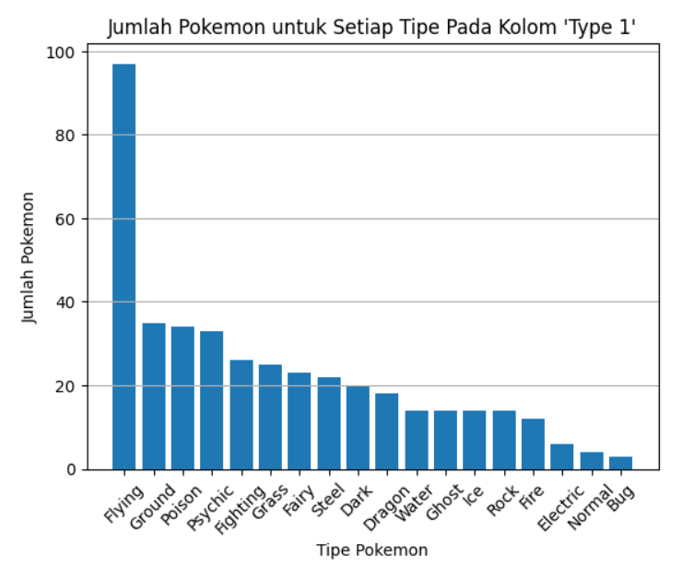
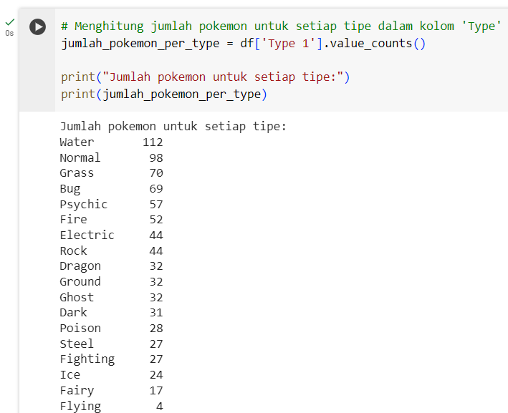
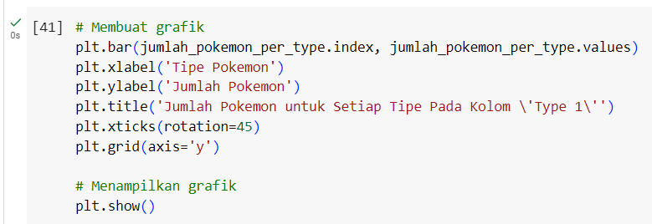
03. NUMBER OF EACH TYPE
In the type 1 column, the results of the number of each type of pokemon are as follows.
The bar chart results are obtained using the program code as follows.

Slide 12
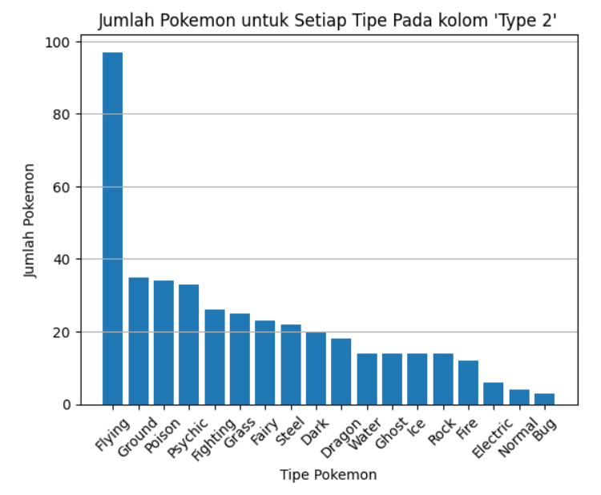
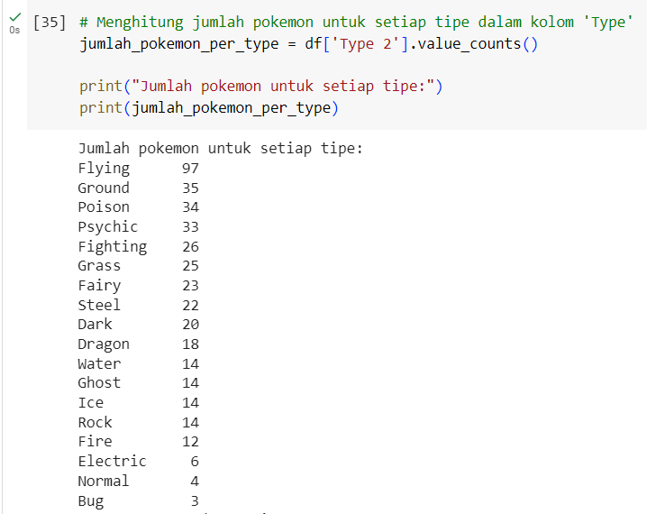
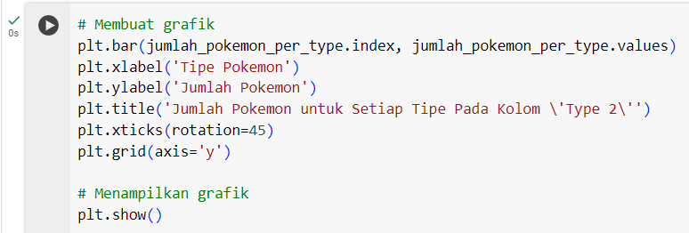
In the type 2 column, the results of the number of each type of pokemon are as follows.
The bar chart results are obtained using the program code as follows.

Slide 13
THANK YOU
Email: muhammadraflifauzi20@gmail.com
LinkedIn:
Muhammad Rafli Fauzi
Instagram:
rafli.fzi

